Slide 1

HOW TO USE SOCIAL MEDIA AS A BUSINESS GROWTH TOOL
CURTIS CARPENTER
PRESIDENT
VERO BEACH SOCIAL MEDIA

Slide 2
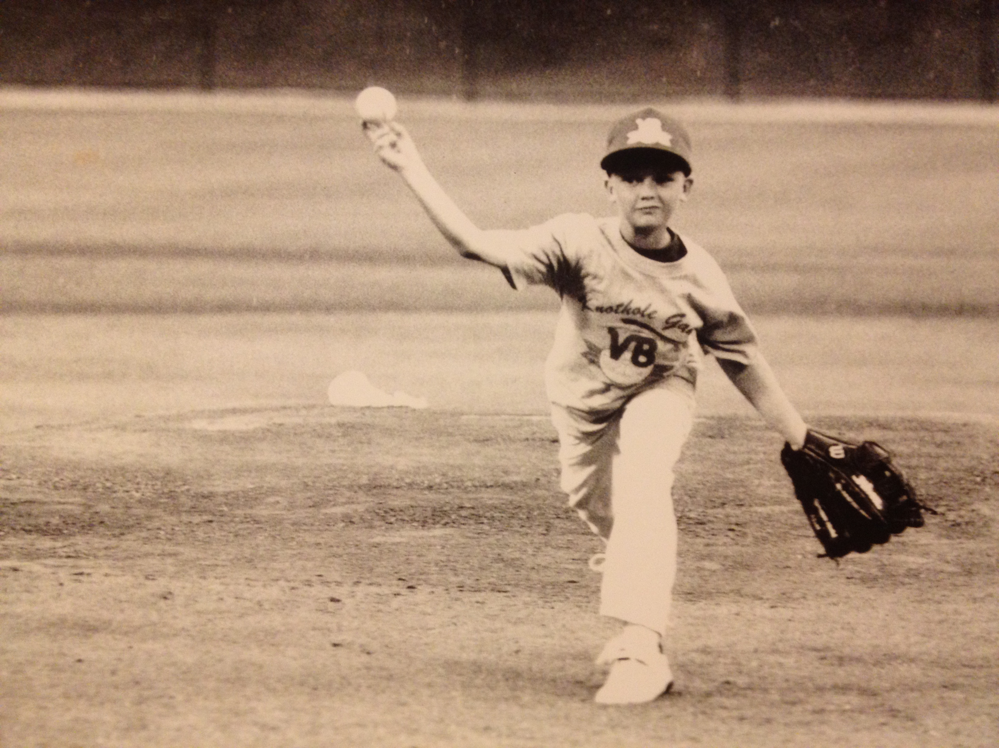
Background
Grew up in Vero Beach
Graduate of Vero Beach High School
Radiology degree from Indian River State College
Spent 13 years in the medical field
Ran political campaigns on the side
Started a digital marketing firm, Citrus Three, in 2017
Sold that and started Vero Beach Social Media August 1, 2021

Slide 3





Why social media?
It’s where everyone is.
Ability to interact with current and potential customers.
Multiple types of content.
Advertising Capabilities

Slide 4
It’s Where Everyone Is
2.9 Billion monthly active users on Facebook.
1.21 Billion monthly active users on Instagram.
1 Billion hours of content watched on YouTube daily.
TikTok was the most visited website in the World in 2021.

Slide 5
Customer interaction
Traditional ‘advertising’ is one way communication.
Social Media allows binary communication.
Social Media groups allow customers to feel special.
Tackle PR issues.

Slide 6
Multiple types of content
Blogs
Photos
Video
Shared Articles

Slide 7
Advertising Capabilities
Cheap Exposure
Specific Targeting
Audience Capture with Re-Targeting
Detailed Insights

Slide 8
Business suggestions
Use the platforms that your audience is typically using.
Post as often as possible.
Engage with your audience.
Be Authentic.
Use the advertising tools at your disposal.

Slide 9
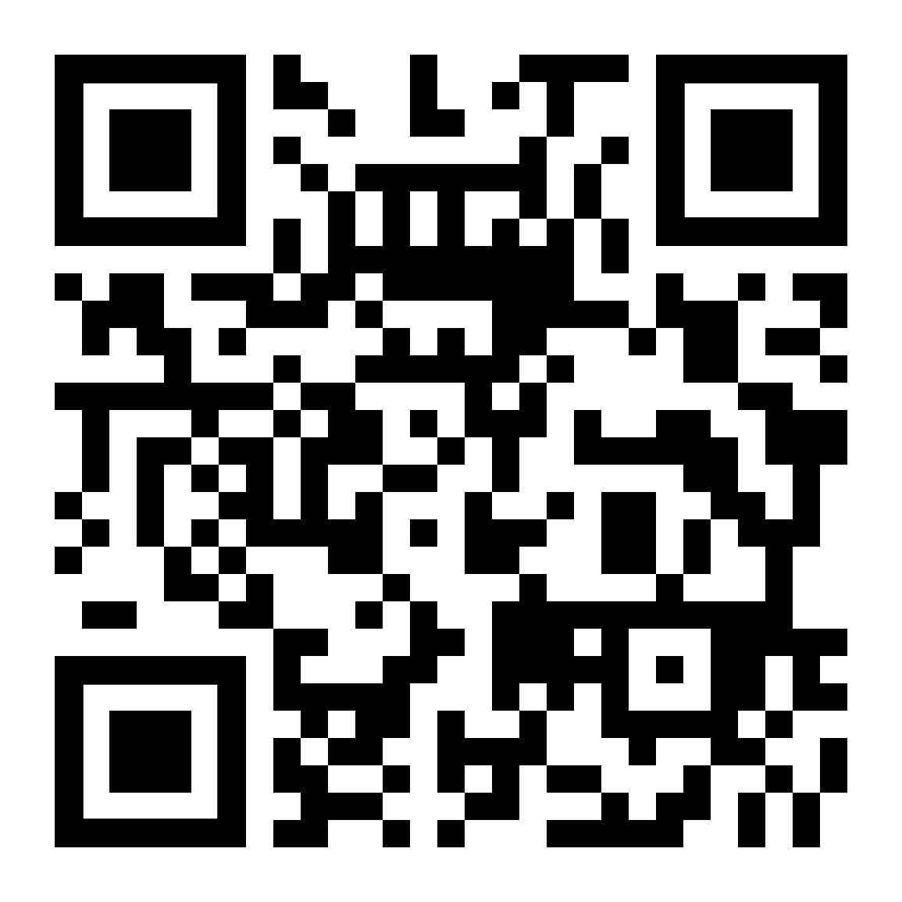
Questions?
Curtis Carpenter
(772) 999-6636
Curtis@VeroBeachSocialMedia.com
www.VeroBeachSocialMedia.com

